Slide 1
Secure Software Engineering COMP47660
Dr. Liliana Pasquale
liliana.pasquale@ucd.ie
http://lili-pasquale.lero.ie

Slide 2
Intro to COMP47660

Slide 3
Relevant Contacts
Lecturer:
Liliana Pasquale (liliana.pasquale@ucd.ie)

Slide 4
Relevant Contacts
Lecturer:
Liliana Pasquale (liliana.pasquale@ucd.ie)
Enrollment on Moodle
Look for COMP47660 Secure Software Engineering 2019
Select secSW as enrollment method
Use password GaryMcGraw

Slide 5
Enroll on Moodle today!
Lecture notes will be posted after each lecture
Assignments and any other material will be posted as we progress through the module
Announcements will be made on Moodle

Slide 6
Schedule (For this week)
Lectures:
Thursdays, 17:00-17:50
Location: BLD71 (Agriculture)
Fridays, 14:00-14:50
Location: B106 (Computer Science)

Slide 7
Why Secure Software Engineering?
Software security has become an important area of interest due to the increasing number of cybersecurity attacks.

Slide 8
Why Secure Software Engineering?
Software security has become an important area of interest due to the increasing number of cybersecurity attacks.
Let’s have a look at some examples…

Slide 9
Mirai (2016)
Malware that turns networked devices running Linux into remotely controlled “bots”.
~600,000 devices were infected.
Notes:
Mirai is a malware that turns networked devices running Linux into remotely controlled "bots" that can be used as part of a botnet in large-scale network attacks.
A bot is an autonomous program on a network which can be controlled remotely.
The cyberattack targeted Internet traffic company DYN, which provides services for websites like Amazon, Spotify and Twitter.

Slide 10
WannaCry (2017)
Ransomware targeting computers running Windows by encrypting data and demanding ransom payments in Bitcoin.
More than 200,000 computers were affected in over 150 countries.
Notes:
The WannaCry ransomware attack was a May 2017 worldwide cyberattack by the WannaCry ransomware cryptoworm, which targeted computers running the Microsoft Windows operating system by encrypting data and demanding ransom payments in the Bitcoin cryptocurrency.

Slide 11
Equifax (2017)
Offenders exploited a vulnerability in Apache Struts.
Personal information of up to 143 million people was disclosed.
Notes:
The specific vulnerability lay in Apache Struts, a framework for creating web applications written in Java. The flaw (identified by the number CVE-2017-5638) was a result of Struts' parser, called Jakarta, mishandling files uploaded to the web server, allowing hackers to remotely run code.

Slide 12
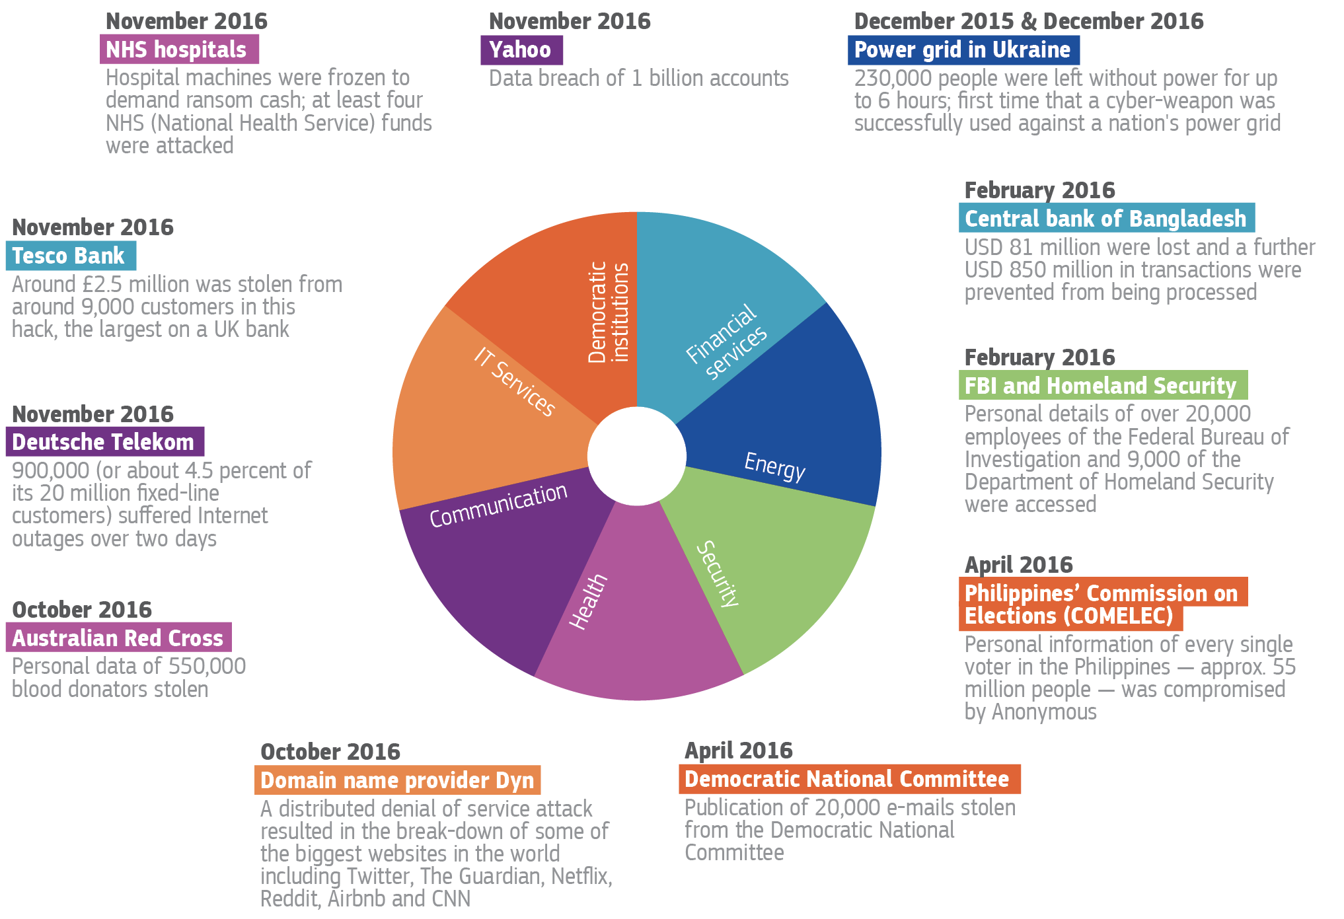
Source: Building an Effective European Cyber Shield, Taking EU Cooperation tothe Next Level.
Notes:
No critical sector can escape cyber threats

Slide 13
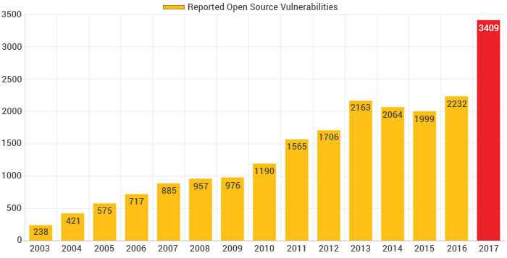
Security Solutions are Still Ineffective
Number of reported open source software defects increased by 51.2% in 2017.
Source: https://www.whitesourcesoftware.com/open-source-vulnerability-management-report/
Notes:
Although software is everywhere and businesses and society come to depend more heavily on software, software defects are increasing.

Slide 14

Why Security Solutions are Still Ineffective? (1/2)
Growing connectivity
Notes:
The growing connectivity of computers through the Internet has increased both the number of attack vectors and the ease with which an attack can be made.
As computer systems are becoming more connected to the Internet, they become vulnerable to software-based attacks from distant sources. An attacker no longer needs physical access to a system to exploit vulnerable software.
Because access through a network does not require human intervention, launching automated attacks is easy.
Extensibility: the degree to which systems have become extensible, a system that accepts updates or extension. For example the plug-in architecture of Web browsers makes it easy to install viewer extensions for new documents types or think about dynamically loadable device drivers.
From an economic standpoint extensible systems are attractive because they provide flexible interfaces that can be adapted through new components.
However extensions can bring defects,
Browser extensions can be called extensions or plugins. The difference is that plugin are simply executables while extensions are shipped with the source code. For example Chrome has several extensions but only 1 plugin for Adobe Flash Player which is disabled by default.
Browser extensions typically have access to sensitive data, such as browsing histoyr and have the ability to alter some browser settings.

Slide 15
Why Security Solutions are Still Ineffective? (1/2)
The number of attack vectors has increased
more vulnerable to software-based attacks from remote sources
Attacks can be launched more easily
i.e. can be launched automatically
Growing connectivity
Notes:
The growing connectivity of computers through the Internet has increased both the number of attack vectors and the ease with which an attack can be made.
As computer systems are becoming more connected to the Internet, they become vulnerable to software-based attacks from distant sources. An attacker no longer needs physical access to a system to exploit vulnerable software.
Because access through a network does not require human intervention, launching automated attacks is easy.
Extensibility: the degree to which systems have become extensible, a system that accepts updates or extension. For example the plug-in architecture of Web browsers makes it easy to install viewer extensions for new documents types or think about dynamically loadable device drivers.
From an economic standpoint extensible systems are attractive because they provide flexible interfaces that can be adapted through new components.
However extensions can bring defects,
Browser extensions can be called extensions or plugins. The difference is that plugin are simply executables while extensions are shipped with the source code. For example Chrome has several extensions but only 1 plugin for Adobe Flash Player which is disabled by default.
Browser extensions typically have access to sensitive data, such as browsing histoyr and have the ability to alter some browser settings.

Slide 16

Why Security Solutions are Still Ineffective? (1/2)
The number of attack vectors has increased
more vulnerable to software-based attacks from remote sources
Attacks can be launched more easily
i.e. can be launched automatically
Growing connectivity
Extensibility
Notes:
The growing connectivity of computers through the Internet has increased both the number of attack vectors and the ease with which an attack can be made.
As computer systems are becoming more connected to the Internet, they become vulnerable to software-based attacks from distant sources. An attacker no longer needs physical access to a system to exploit vulnerable software.
Because access through a network does not require human intervention, launching automated attacks is easy.
Extensibility: the degree to which systems have become extensible, a system that accepts updates or extension. For example the plug-in architecture of Web browsers makes it easy to install viewer extensions for new documents types or think about dynamically loadable device drivers.
From an economic standpoint extensible systems are attractive because they provide flexible interfaces that can be adapted through new components.
However extensions can bring defects,
Browser extensions can be called extensions or plugins. The difference is that plugin are simply executables while extensions are shipped with the source code. For example Chrome has several extensions but only 1 plugin for Adobe Flash Player which is disabled by default.
Browser extensions typically have access to sensitive data, such as browsing histoyr and have the ability to alter some browser settings.

Slide 17
Why Security Solutions are Still Ineffective? (1/2)
The number of attack vectors has increased
more vulnerable to software-based attacks from remote sources
Attacks can be launched more easily
i.e. can be launched automatically
Growing connectivity
Software extensions are developed by 3rd parties and thus cannot be controlled:
they can be malware and cause unwanted effects on the original application.
Extensibility
Notes:
The growing connectivity of computers through the Internet has increased both the number of attack vectors and the ease with which an attack can be made.
As computer systems are becoming more connected to the Internet, they become vulnerable to software-based attacks from distant sources. An attacker no longer needs physical access to a system to exploit vulnerable software.
Because access through a network does not require human intervention, launching automated attacks is easy.
Extensibility: the degree to which systems have become extensible, a system that accepts updates or extension. For example the plug-in architecture of Web browsers makes it easy to install viewer extensions for new documents types or think about dynamically loadable device drivers.
From an economic standpoint extensible systems are attractive because they provide flexible interfaces that can be adapted through new components.
However extensions can bring defects,
Browser extensions can be called extensions or plugins. The difference is that plugin are simply executable while extensions are shipped with the source code. For example Chrome has several extensions but only 1 plugin for Adobe Flash Player which is disabled by default.
Browser extensions typically have access to sensitive data, such as browsing history and have the ability to alter some browser settings.

Slide 18
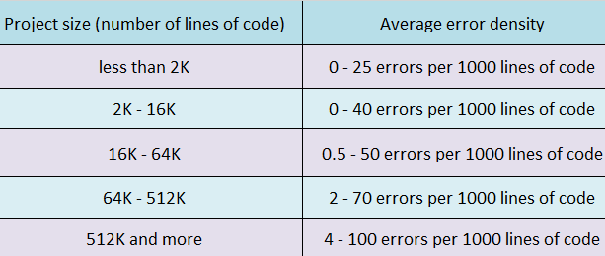
Why Security Solutions are Still Ineffective? (2/2)
Growing Complexity
More Lines,
more bugs (Dan Geer)
Complexity
https://hownot2code.com/2017/11/08/search-for-bugs-in-code-at-the-early-stage/

Slide 19
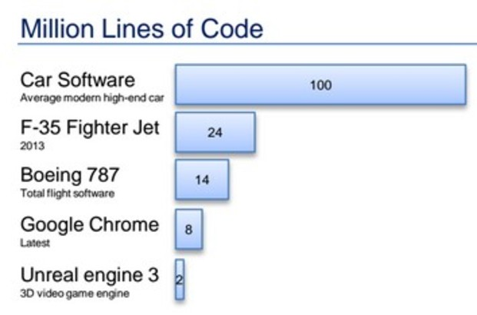
Why Security Solutions are Still Ineffective? (2/2)
Growing Complexity
More Lines,
more bugs (Dan Geer)
Complexity
https://hownot2code.com/2017/11/08/search-for-bugs-in-code-at-the-early-stage/
https://www.startupdelta.org/high-tech-scale-ups-finding-software-bugs-that-often-slip-through/

Slide 20
How can we solve the problem?
Be more proactive
Apply software security best practices to various artifact during application development (software security touchpoints)
Promote secure software engineering training
The demand for cybersecurity experts is expected to rise to 6 million globally by 2019
There will be 3.5 million unfilled cybersecurity positions by 2021
—- CloudPassage, 2016

Slide 21
Objectives
To introduce you to the field of secure software engineering

Slide 22

Objectives
To introduce you to the field of secure software engineering
Build Software
—- Gary McGraw, “Software Security – Building Security In”

Slide 23
Objectives
To introduce you to the field of secure software engineering
Build Software
Break Software
—- Gary McGraw, “Software Security – Building Security In”

Slide 24
Objectives
To introduce you to the field of secure software engineering
Build Software
Fix Software
Break Software
—- Gary McGraw, “Software Security – Building Security In”

Slide 25
Objectives
To introduce you to the field of secure software engineering
Build Secure Software
Fix Software
Break Software
—- Gary McGraw, “Software Security – Building Security In”

Slide 26
Objectives
To introduce you to the field of secure software engineering
Knowing
Identify key security concepts and threats to software systems;
Distinguish the most common classes of vulnerabilities in software projects;
Select countermeasures that could be applied to mitigate vulnerabilities;

Slide 27
Objectives
To introduce you to the field of secure software engineering
Acting
Identify and exploit security vulnerabilities in software projects;
Develop patches to remove vulnerabilities from existing software projects;

Slide 28
Objectives
To introduce you to the field of secure software engineering
Being
Work in teams, share work fairly and meet the obligations set by the group;
Be curious about latest security vulnerabilities and patches;
Actively Promote security practices

Slide 29
Outline of the Module
Part 1 (Build It): Learning how to build web applications using Springboot + Hibernate
Part 2 (Break It): Top 10 OWASP Software vulnerabilities
Part 3 (Fix it): Building patches to fix software vulnerabilities

Slide 30
Outline of the Module
Part 1 (Build It): Learning how to build web applications using Springboot + Hibernate
Assignment 1: Implement in a team of 3 a very simple web application simulating a hotel reservation system (20%)
Part 2 (Break It): Top 10 OWASP Software vulnerabilities
Assignment 2: You will be given a web application developed by another team and have to discuss how vulnerabilities can be exploited (40%)
Part 3 (Fix it): Building patches to fix software vulnerabilities
Assignment 3: Fix the vulnerabilities that were discovered in your web application (30%)

Slide 31
Outline of the Module
Part 1 (Build It): Learning how to build web applications using Springboot + Hibernate
Assignment 1: Implement in a team of 3 a very simple web application simulating a hotel reservation system (20%)
Due Mar 1
Part 2 (Break It): Top 10 OWASP Software vulnerabilities
Assignment 2: You will be given a web application developed by another team and have to discuss how vulnerabilities can be exploited (40%)
Due Apr 8
Part 3 (Fix it): Build patches to fix software vulnerabilities
Assignment 3: Fix the vulnerabilities that were discovered in your web application (30%)
Due Apr 30

Slide 32
Assignments
Assignments will be performed in teams of 3 students
Form your team now!
https://docs.google.com/spreadsheets/d/11dYWL36QprSLhDpIqbOfjvYOL57M3JrDW1s7VVsGgHY/edit?usp=sharing

Slide 33

Assignment Submission
Deliverable deadlines are on the main module page
Late submissions
NOT by e-mail
Moodle assignments will remain open for submission after due dates to accommodate late submissions, but penalties will apply:
Up to 1 week late: 10% deduction
Up to 2 weeks late: 20% deduction
More than 2 weeks late: 50% deduction

Slide 34
Group presentations
Instructional Material: Each group will be tasked to create instruction material describing a vulnerability of their choice. (10%)
You can use any media: video recordings, power point presentation, word document
The produced material will be presented in the last lecture.

Slide 35
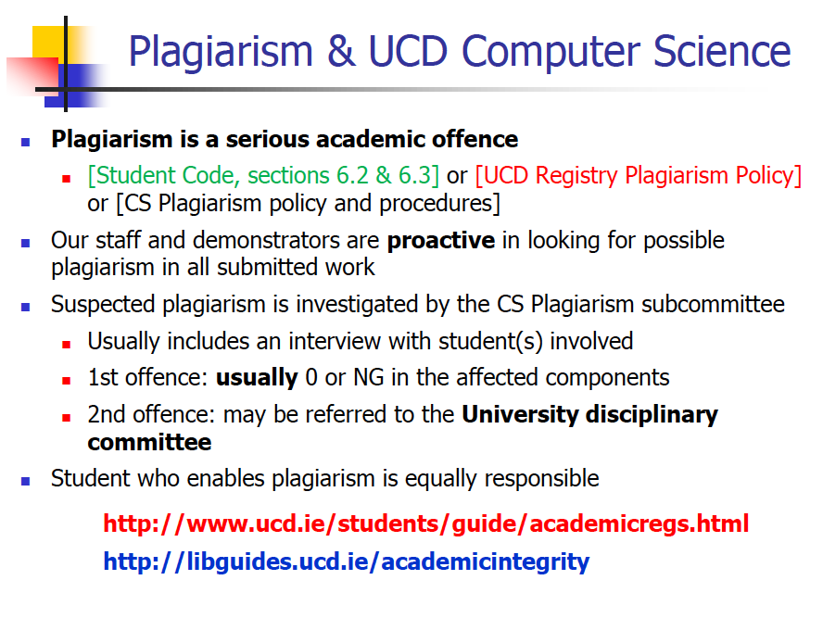

Slide 36



Essential Sources of Information
Open Web Application Security project (OWASP)
Bruce Schneier’s Blog
https://www.schneier.com
Subscribe to CRYPTO-GRAM mailing list
Gary McGraw’s Silver Bullet Security Podcast
https://www.synopsys.com/software-integrity/resources/podcasts.html
Notes:
OWAS is a worldwide not-for-profit charitable organization focused on improving the security of software.
OWASP mission is to make software security visible so that individuals and organizations are able to make informed decisions.
OWASP provides impartial, practical information about AppSec to individuals, corporations, universities, government agencies, and other organizations worldwide. OWASP issues software tools and knowledge0based documentation on application security

Slide 37
Introduction to Secure Software Engineering

Slide 38
Objectives
Intro to Security and Security Engineering
Security Requirements
Confidentiality, Integrity, Availability and Accountability
Security Levels
Infrastructure, Application and Operation Security
Security Concepts
Asset, Vulnerability, Attack, Threat, Exposure

Slide 39
Security Engineering
Tools, techniques and methods to support the development and maintenance of software systems that are secure, i.e. can resist malicious attacks that are intended to damage the system itself or its data.
A sub-field of the broader field of computer security

Slide 40
Security
A requirement (or property) of a software system that reflects the system ability to protect itself from a deliberate external attack.
Security is very different from Safety!

Slide 41
Security Requirements
Confidentiality
Information in a system may be disclosed or made accessible to people or programs that are not authorized to have access to that information
Integrity
Information in a system may be damaged or corrupted making it hard to use or unreliable
Availability
Access to a system or its data that is normally available may no longer be possible
Accountability
The traceability of actions performed on a system to a specific system entity (user, process, device).

Slide 42
Security Requirements
Confidentiality
Information in a system should only be disclosed or made accessible to authorized people or programs
Integrity
Information in a system should not be damaged or corrupted
Availability
Access to a system or its data should always be possible
Accountability
The traceability of actions performed on a system to a specific system entity (user, process, device).

Slide 43
Security Requirements
Confidentiality
Information in a system should only be disclosed or made accessible to authorized people or programs
Integrity
Information in a system should not be damaged or corrupted
Availability
Access to a system or its data should always be possible
Accountability
The traceability of actions performed on a system to a specific system entity (user, process, device).

Slide 44
Security Requirements
Confidentiality
Information in a system should only be disclosed or made accessible to authorized people or programs
Integrity
Information in a system should not be damaged or corrupted
Availability
Access to a system or its data should always be possible
Accountability
The traceability of actions performed on a system to a specific system entity (user, process, device).

Slide 45
Security Requirements
Confidentiality
Information in a system should only be disclosed or made accessible to authorized people or programs
Integrity
Information in a system should not be damaged or corrupted
Availability
Access to a system or its data should always be possible
Accountability
Actions performed on a system to a specific system entity (user, process, device) should be recorded.

Slide 46
WannaCry (2017)
Ransomware targeting computers running Windows by encrypting data and demanding ransom payments in Bitcoin.
More than 200,000 computers were affected in over 150 countries.
Notes:
The WannaCry ransomware attack was a May 2017 worldwide cyberattack by the WannaCry ransomware cryptoworm, which targeted computers running the Microsoft Windows operating system by encrypting data and demanding ransom payments in the Bitcoin cryptocurrency.

Slide 47
Equifax (2017)
Offenders exploited a vulnerability in Apache Struts.
Personal information of up to 143 million people was disclosed.
Notes:
The specific vulnerability lay in Apache Struts, a framework for creating web applications written in Java. The flaw (identified by the number CVE-2017-5638) was a result of Struts' parser, called Jakarta, mishandling files uploaded to the web server, allowing hackers to remotely run code.

Slide 48

Marriot Security Incident
An unauthorized party had copied and encrypted information, and took steps towards removing it

Slide 49
A study [King et al.] on health records management systems indicates that:
OpenEMR, an open source systems only collects ~60% of the events that could indicate misuse of health records
Other open source (Tolven and eCHR) and proprietary systems (EHR) only collects ~19% of the events that could indicate misuse of health records
King, Jason, Ben Smith and Laurie Williams. "Audit Mechanisms in Electronic Health Record Systems: Protected Health Information May Remain Vulnerable to Undetected Misuse," International Journal of Computational Models and Algorithms in Medicine (IJCMAM) 3 (2012): 2

Slide 50
Security Levels
Infrastructure Security
Refers to all systems (e.g., physical machines, operating systems, databases) and networks that provide an infrastructure and a set of shared services to the organization
Application Security:
Refers to individual software systems
Operational Security
ensuring that people do note take actions that may compromise infrastructure and application security (e.g., tell others passwords, leave computers with users logged on)

Slide 51
Security Concepts
Term | Definition
Asset | Something of value which has to be protected. Assets may be the software system itself or data processed by that system.
Vulnerability | A defect or a weakness in system security procedures, design, implementation that can be exercised and result in a security breach or violation of a security policy.
Attack | An exploitation of a software system’s vulnerability.
Countermeasure or Safeguard | Management, operational and technical controls prescribed to protect software system.
Threat | The actor or agent who is the source of danger. In other words , the danger posed by a malicious agent (e.g., fraudster, attacker, malicious hacker) for a variety of motivations (e.g., financial gain, prestige).

